Slide 1

TPS: PRODUCT ORDER TRACKING SYSTEM
(P.O.T.S)
DEVELOPERS: MAYO, JONATHAN LANCE S.
VILLEGAS, ALLYZA FE E.
Excellence and Relevance

Slide 2
INTRODUCTION
Adoption of a digitalized business model is becoming more practical.
Major changes have occurred in the business industry due to this shift.
Innovative business models have introduced new products and services.
Company relationships with customers and employees have been extended.
Digital adoption significantly increased the viability of MSMEs.
MSMEs' digital adoption positively impacted business operations, market operations, and product distribution.
Not all transitions are driven by performance; some are necessary adaptations.

Slide 3
PROBLEM SCENARIO
Business: Dorothy’s Cakes and Pastries (private business).
Provides baked products. (cakes, pastries, desserts) and catering services.
Customizes orders based on customer preferences.
Team: 4-person team (owner is head baker/pastry chef, co-operator handles logistics and assists in high-demand operations).
Current issues: Operational inefficiencies and capacity limitations.
Solution: Implement various technologies using basic Java applications.

Slide 4
SUSTAINABLE DEVELOPMENT GOALS
Sustainable Development Goals (SDGs)
SDG 12 (Responsible Consumption and Production):
Implement a digital ordering-tracking system
Reduce dependence on paper and ink, lowering the carbon footprint
SDG 9 (Industry, Innovation, and Infrastructure):
Focus on SMEs
Improve productivity, efficiency, and economic contribution
Reduce waste and increase overall contribution to society

Slide 5
PROJECT OBJECTIVES
Digital Order Tracking System:
Record, keep, and track business transactions (sales, inventory, profits/revenue)
Provide a datasheet for business practice modifications
Ease of Order Collection:
Address problems with traditional order collection methods (e.g., physical data/paper)
Easy Order Manipulation:
Allow users to manipulate existing orders based on customer changes and feedback

Slide 6
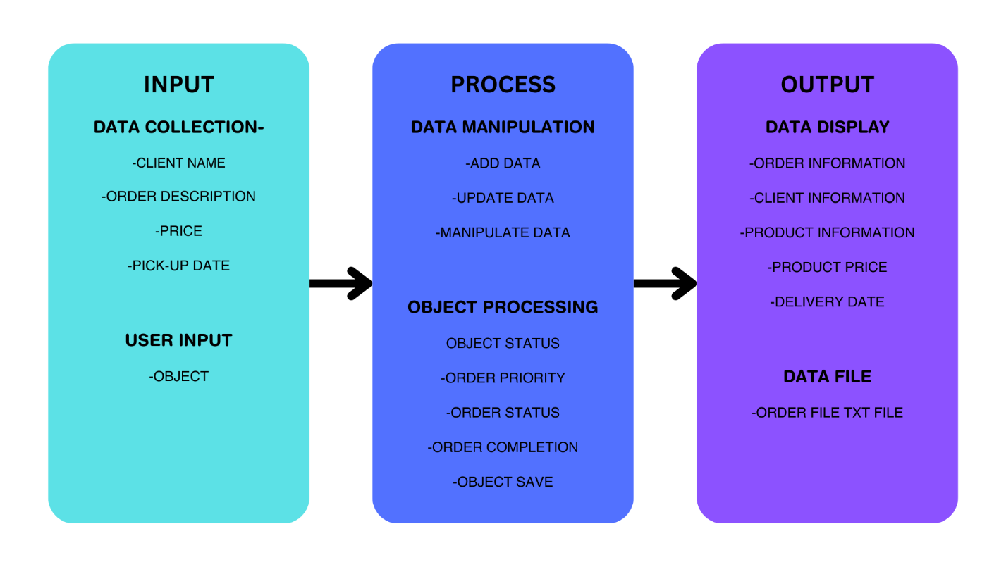
Conceptual Framework

Slide 7
TARGET MARKET
Project Aim
Provide SMEs & SMBs with a lightweight, portable, dedicated order-tracking system.
System contains detailed information about the products.
Basic implementation allows for open-source modifications.
Customizable to specific business needs
Potential Applications
Cakes and pastries businesses
Catering services
Custom job orders
Various other business types

Slide 8

PROJECT DEFINITION
Type: Graphical-User-Interface (GUI) based application
Purpose: Taking orders and providing useful data for managing various transactions
Programming Language: Java
Advantages:
Portability
Ease of code
Common syntax based on C and C++

Slide 9
PROJECT DEFINITION
Packages Used:
Java.AWT.*:
-Abstract Window Toolkit (AWT)
-Facilitates GUI functionality and Windows-based applications
Java.time.*:
-API for date and time-related functionalities
Java.util.*:
-Collection frameworks, legacy functions, and other functionalities for complicated processes
javax.swing.*:
-Platform-independent and lightweight components for various GUI functionalities

Slide 10
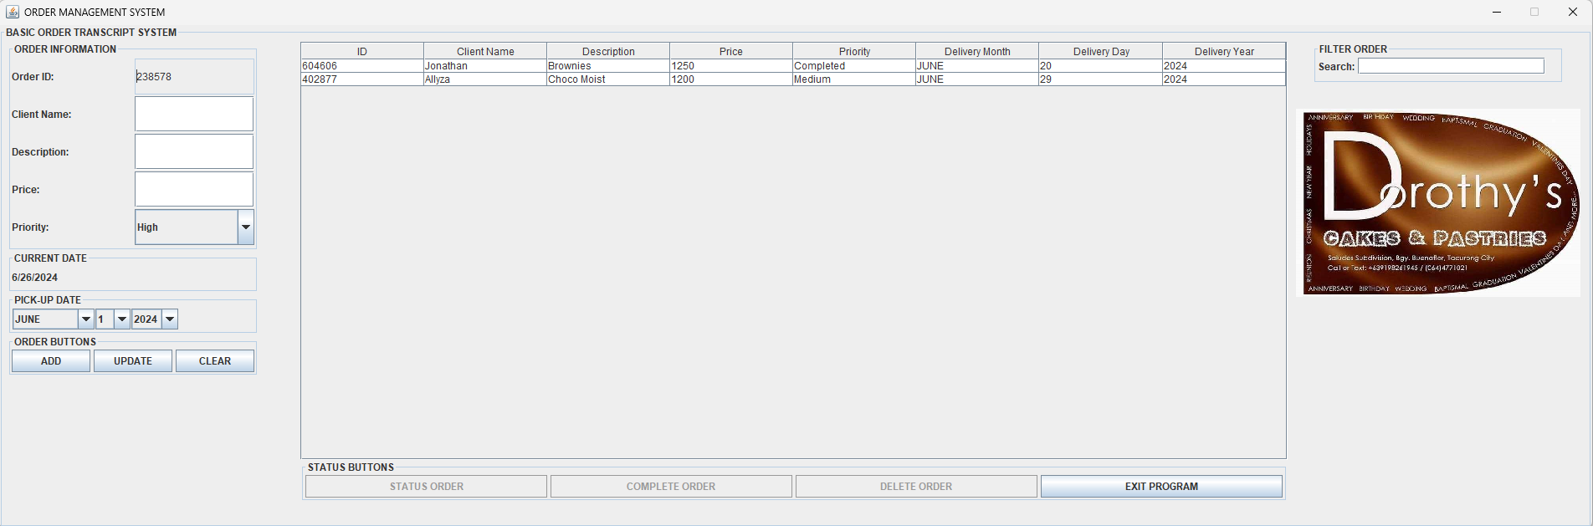
PROJECT SYSTEM/PROTOTYPING
PROJECT/SYSTEM PROTOTYPING
Figure 2.1. Application Menu/Start.

Slide 11
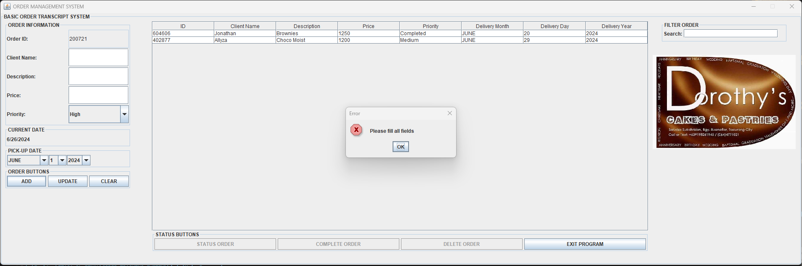
PROJECT SYSTEM/PROTOTYPING
SAMPLE INPUT/OUTPUT
Figure 3.1. INPUT (No DATA)

Slide 12

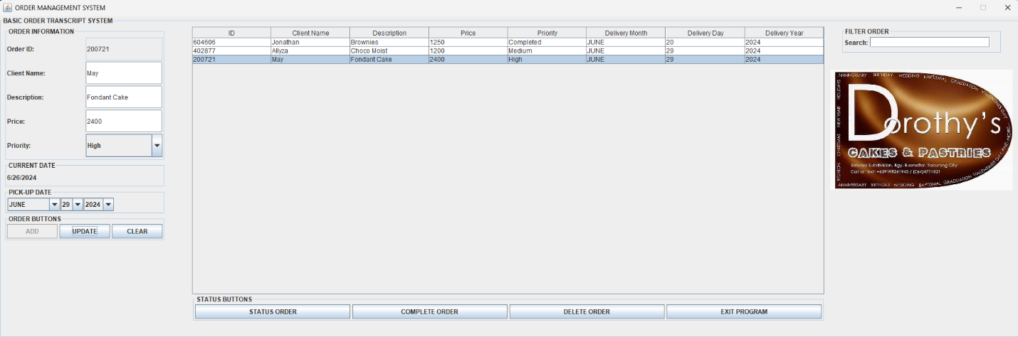
PROJECT SYSTEM/PROTOTYPING
Figure 3.2. INPUT (DATA ADD)
Figure 3.3. INPUT (DATA UPDATE)

Slide 13


PROJECT SYSTEM/PROTOTYPING
Figure 3.4. OUTUT (CHANGE STATUS/PRIORITY)
Figure 3.5. OUTPUT (CHANGE TO COMPLETE)

Slide 14


PROJECT SYSTEM/PROTOTYPING
FIGURE 3.6. ORDER DELETED.
Figure 3.7. ORDER FILTER.

Slide 15
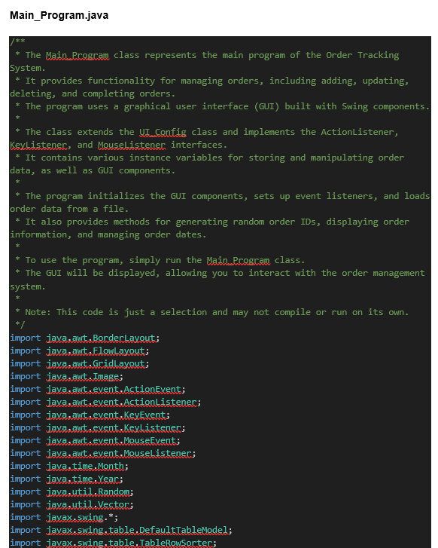
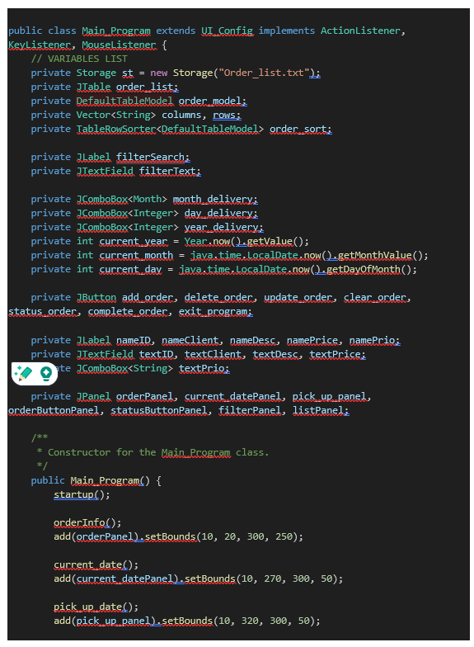
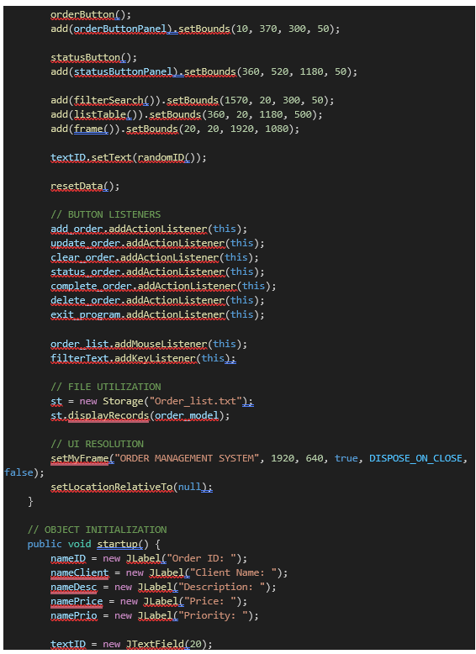
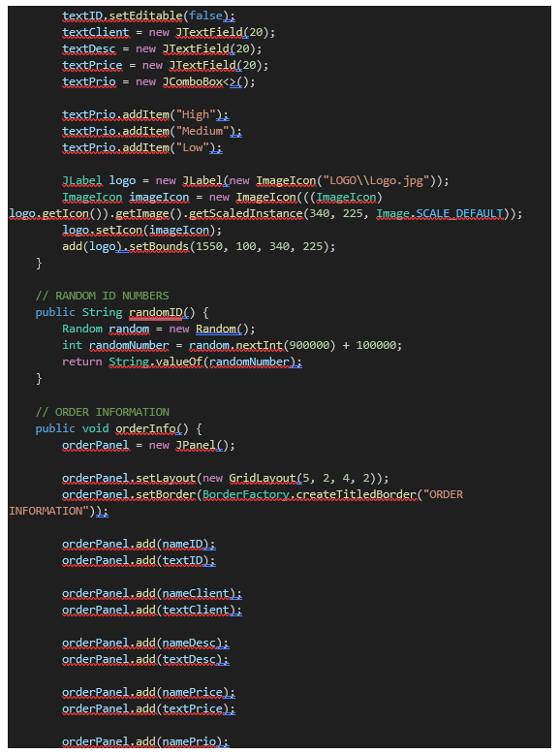
SOURCE CODE
MAIN_PROGRAM

Slide 16
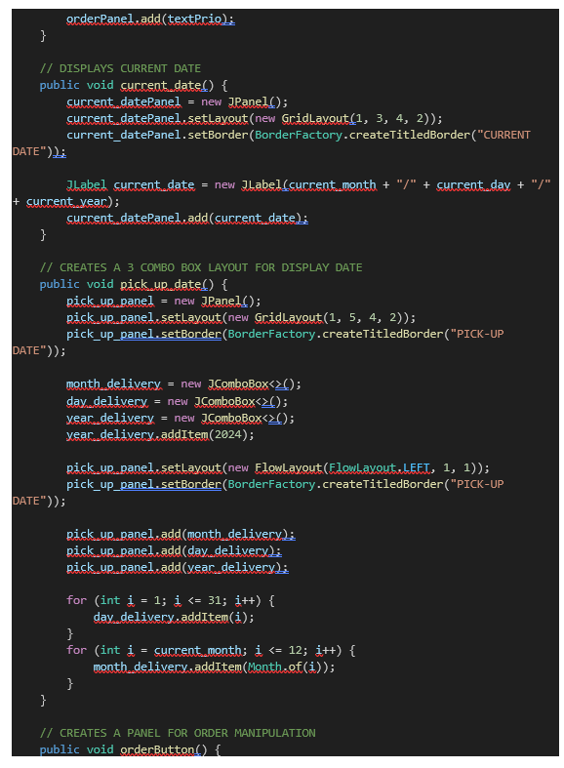
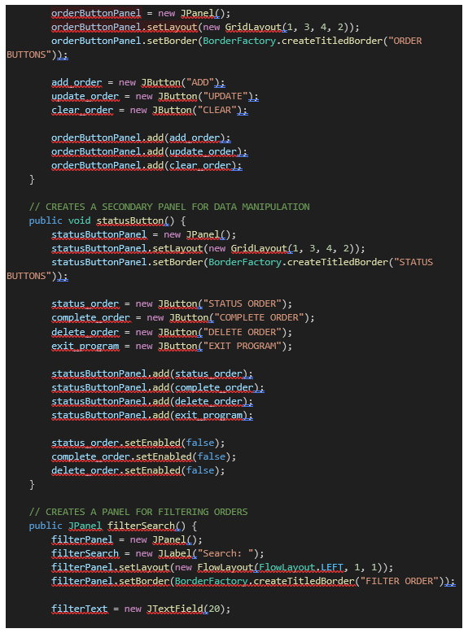
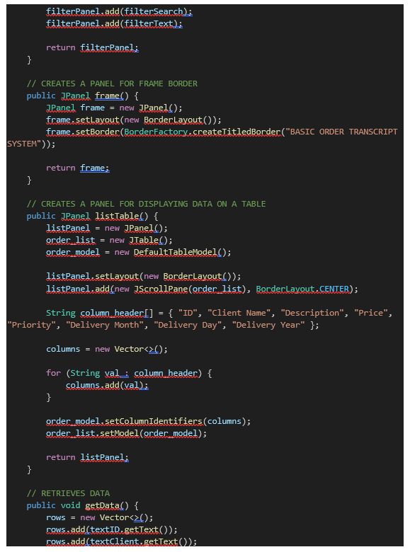
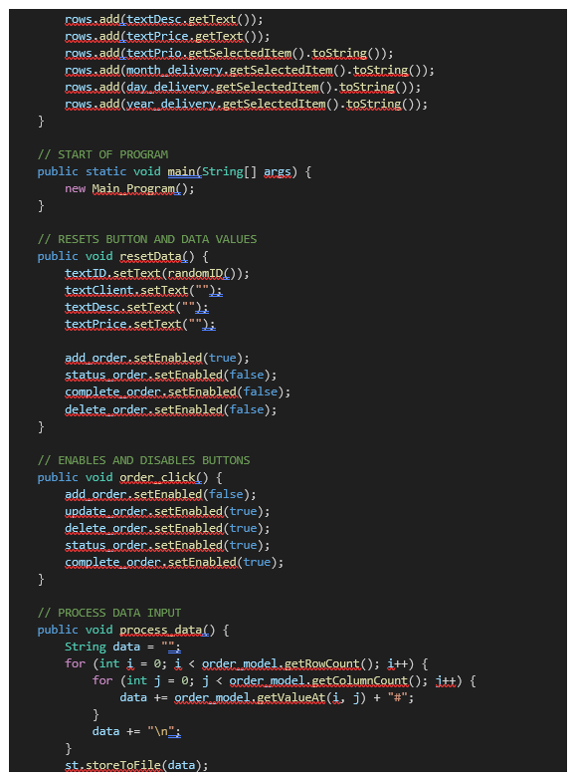
SOURCE CODE
MAIN_PROGRAM

Slide 17
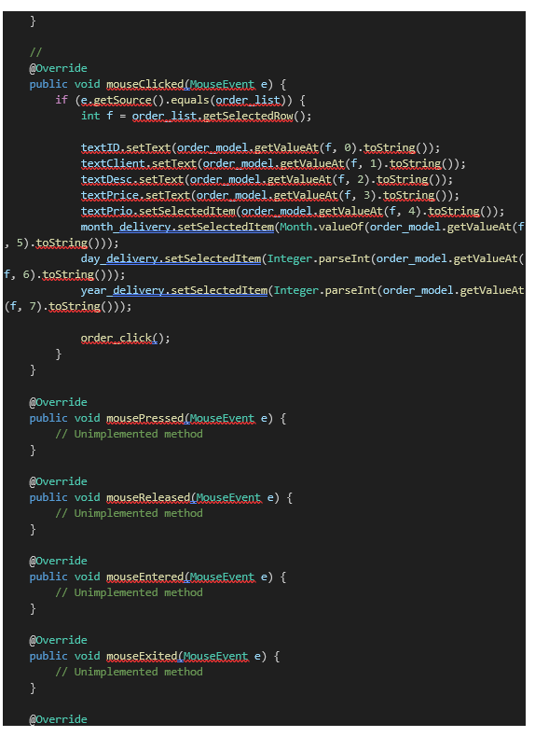
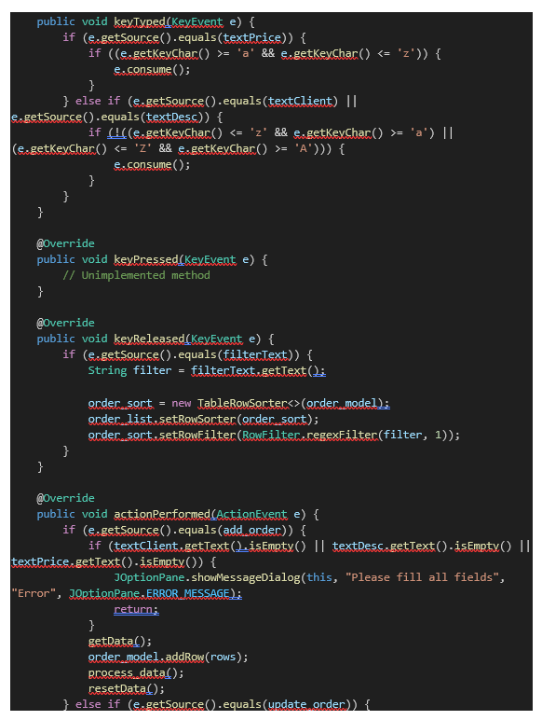
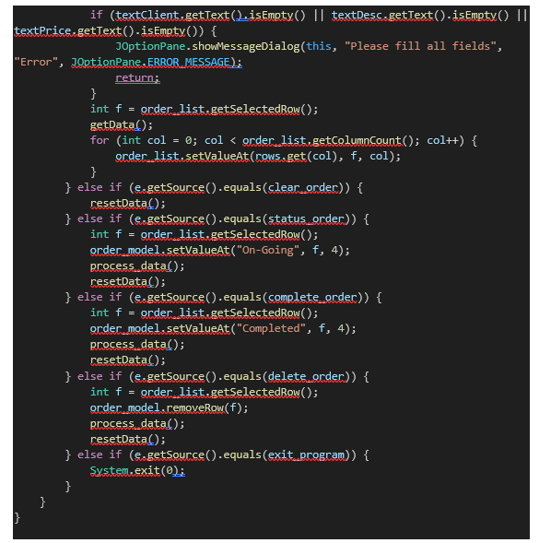
SOURCE CODE
MAIN_PROGRAM

Slide 18
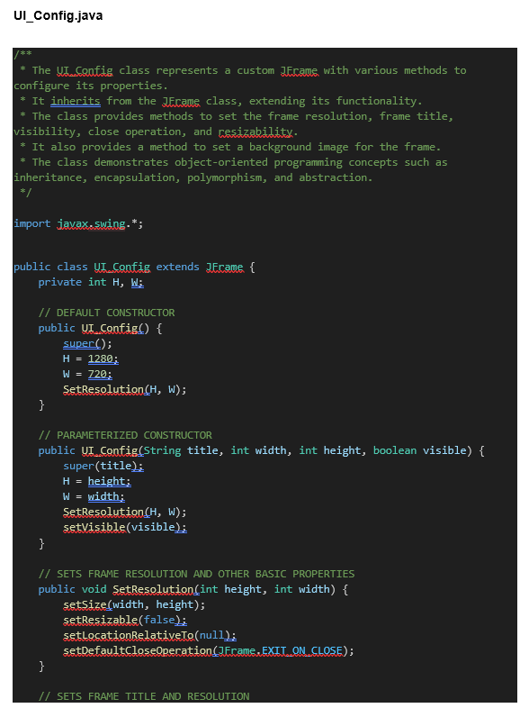
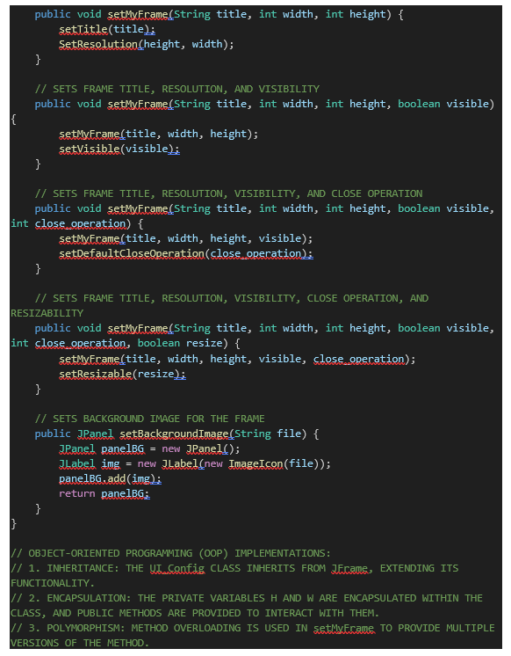

SOURCE CODE
UI_Config

Slide 19
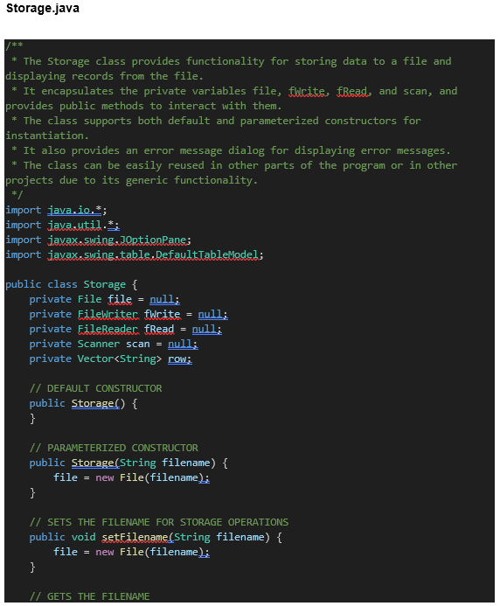
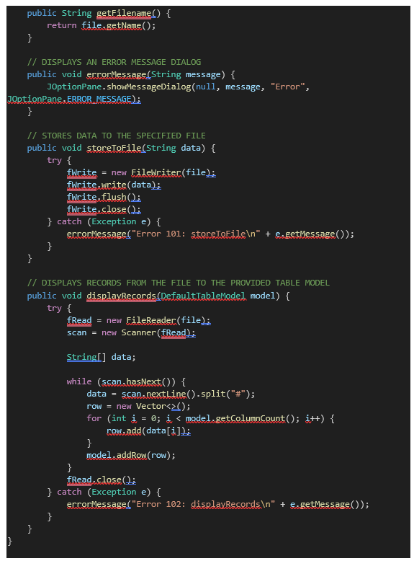
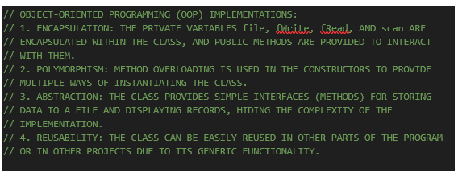
SOURCE CODE
Storage

Slide 20
REFERENCES
Rachinger, M., Rauter, R., Müller, C., Vorraber, W., & Schirgi, E. (2019, December 9). Digitalization and its influence on business model innovation. Journal of Manufacturing Technology Management, 30(8), 1143–1160. https://doi.org/10.1108/jmtm-01-2018-0020
PwC Philippines (2020).Innovation and digital transformation: How are Philippine MSMEs performing? https://www.pwc.com/ph/en/publications/ph-columns/business-unusual/2020/innovation-and-digital-transformation-how-are-philippine-msmes-performing.html
Team, D. (2024, May 27). How can going paperless reduce your carbon footprint? Document Management Software | Docsvault. https://www.docsvault.com/blog/how-can-going-paperless-reduce-your-carbon-footprint/
Yip, T. (2023, September 5). Benefits of Digital Transformation for SMEs: How to stay ahead of the competition. https://www.linkedin.com/pulse/benefits-digital-transformation-smes-how-stay-ahead-competition-yip/
What is Java? | IBM. (n.d.). https://www.ibm.com/topics/java

Slide 21
END OF PRESENTATION
Excellence and Relevance

